Slide 1
CIVE 650 – Spatiotemporal Data Mining
Spatio-Temporal Modeling of Land Surface Temperature: A Comparison of IDW, Random Forest, and Sparse Gaussian Processes
Course project Presentation
Presenter: Xiaoning Sun
Student number: 261162300

Slide 2
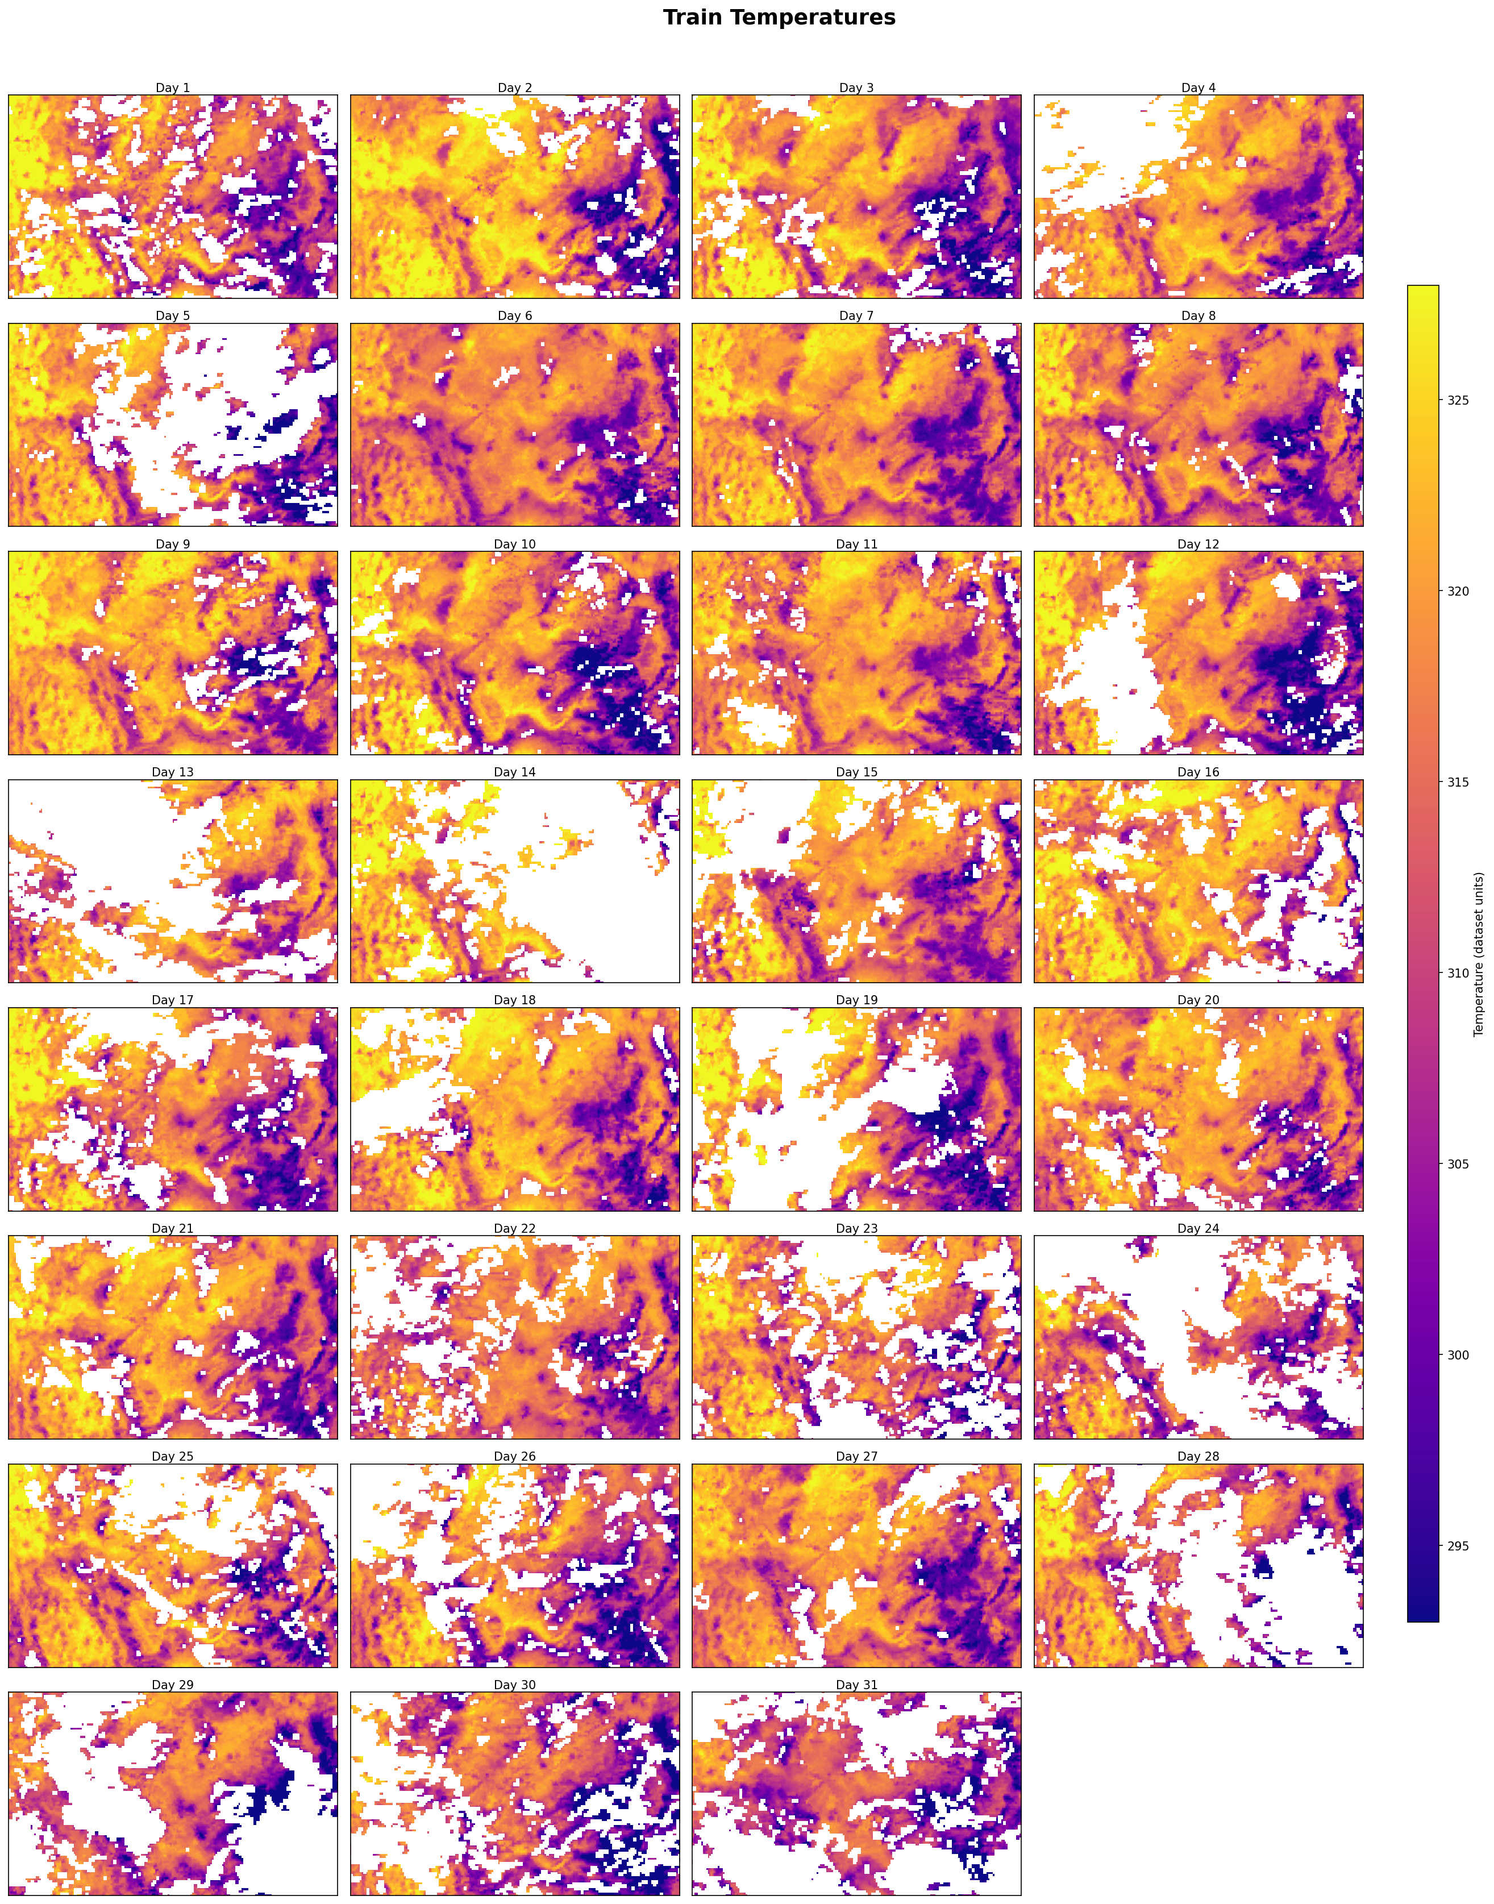
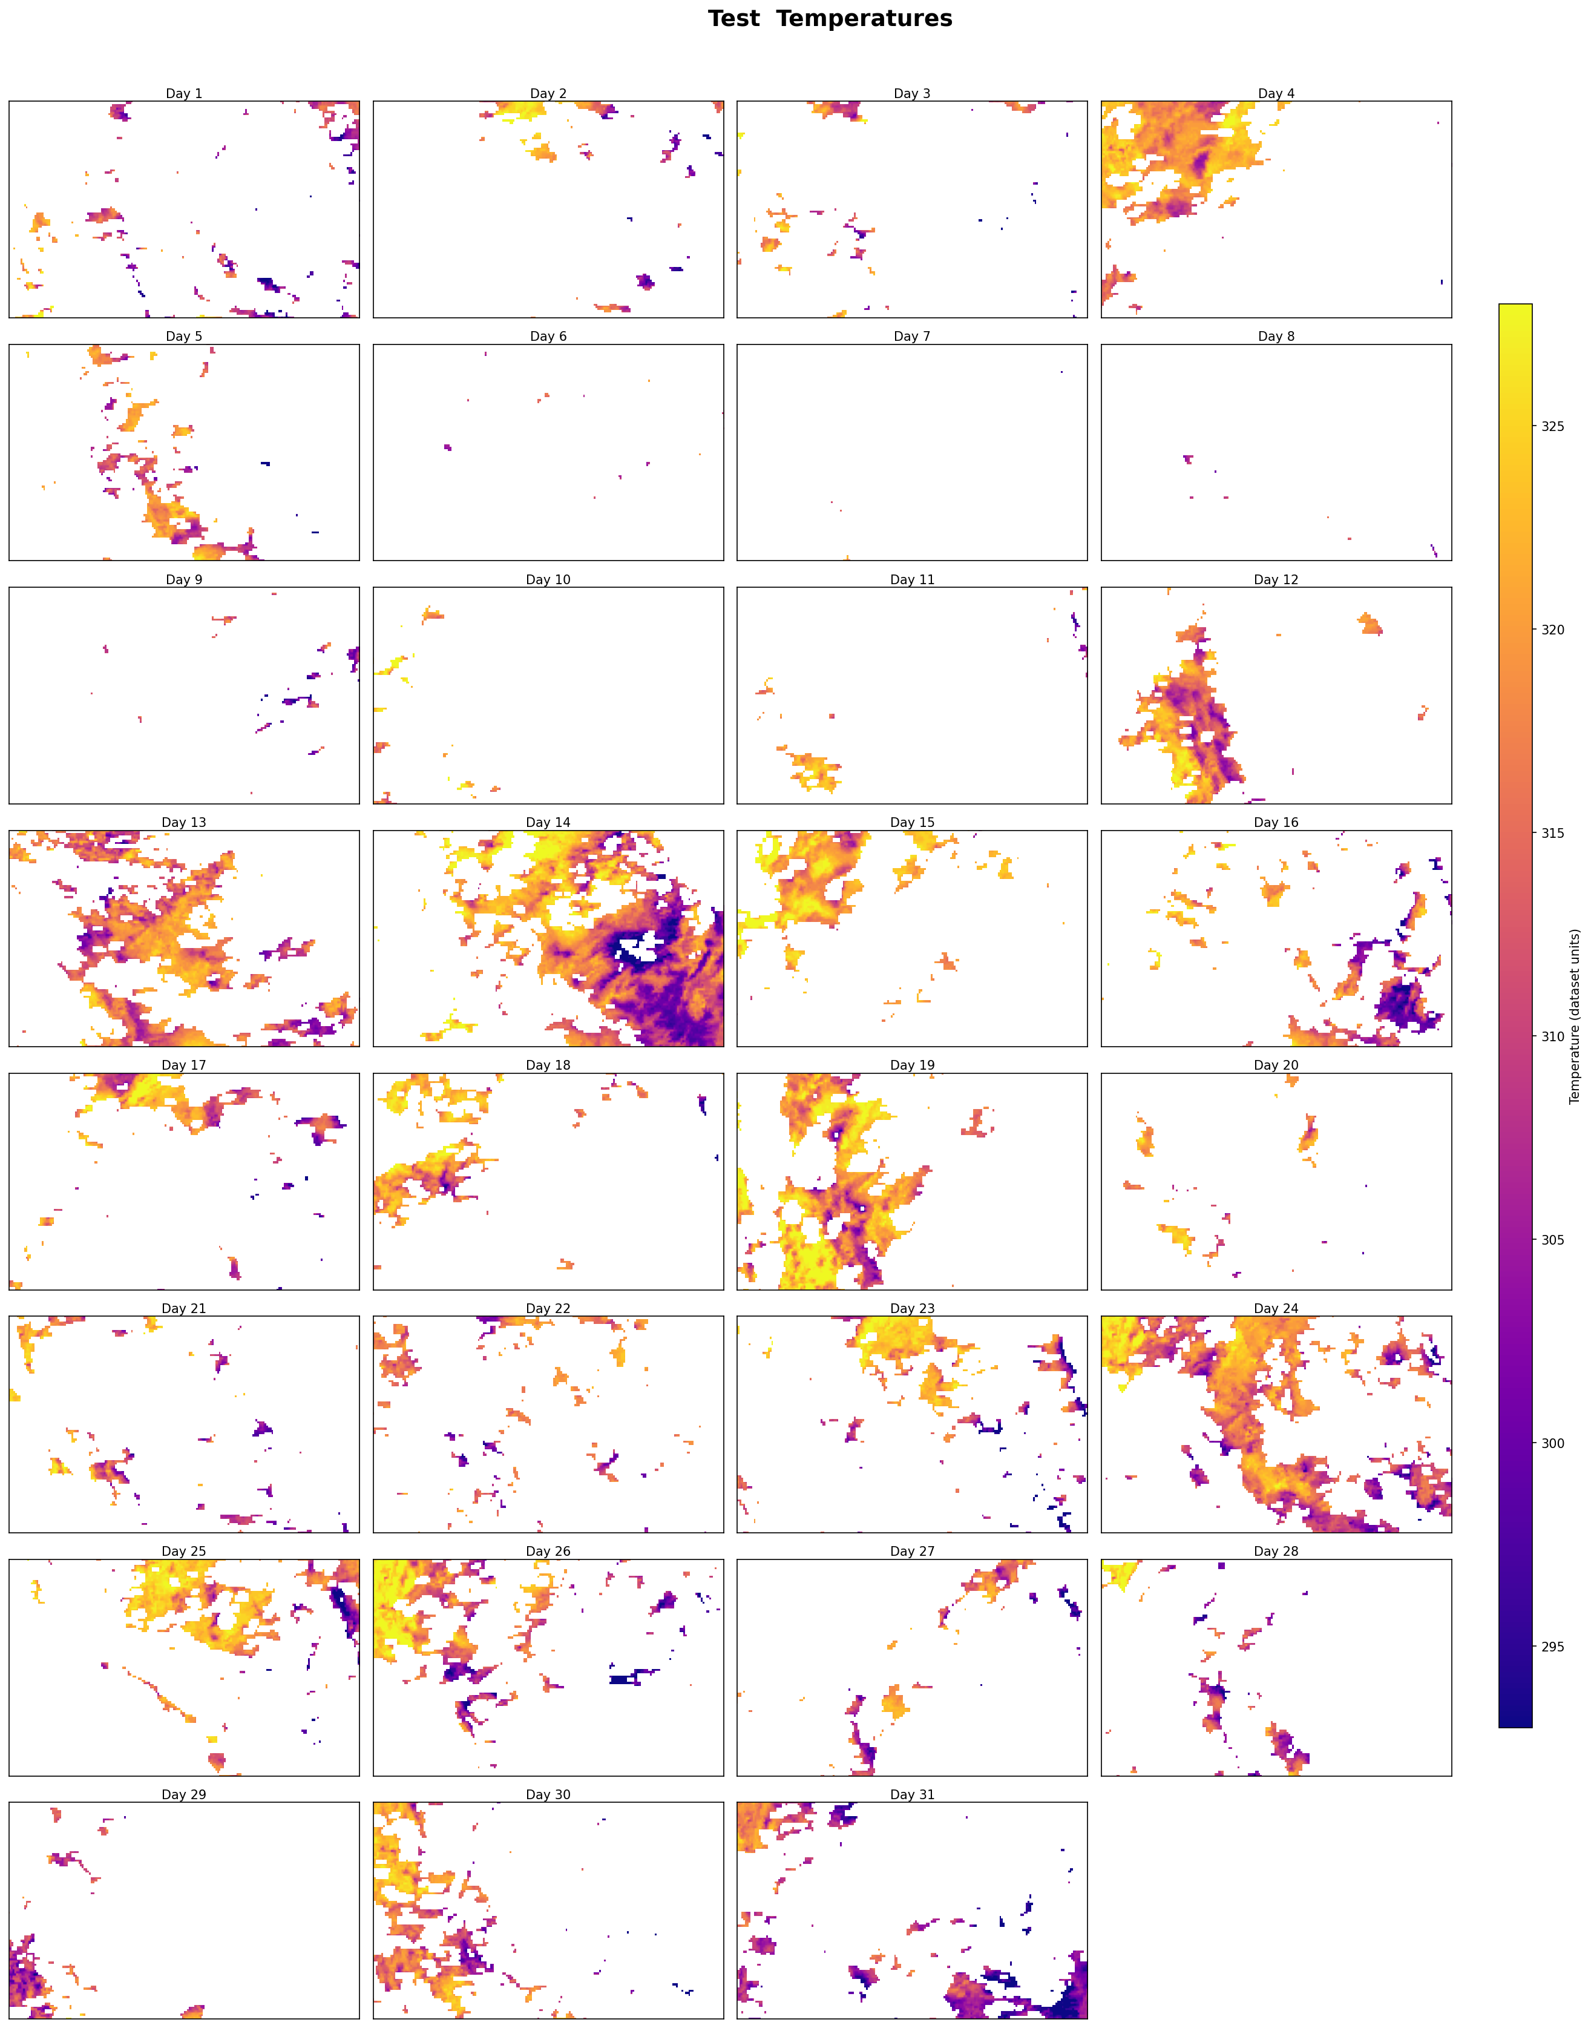
1. Background and Introduction
Objective of the project:
Develop probabilistic interpolation models for land surface temperature (LST) data collected from the MODIS satellite platform.
Dataset: 100 × 200 × 31 (latitude × longitude × days)
Latitude: 35°to 40°N (100 grid points)
Longitude: −115°to 105°W (200 grid points)
Time: 31 consecutive days
494,762 training points
85,942 test points
No overlap between training and test sets.
1/11
Training set
Test set
1/18

Slide 3
2. Project Questions & Objectives
Q1. Model Performance
How well do models reconstruct MODIS LST?
IDW, Random Forest (RF), Sparse Variational Gaussian Process (SVGP)
Q2. Kernel Design
Which covariance kernels best capture LST structure in (lon, lat, time)?
Linear, RBF, Matern 3/2, Matern 5/2, RQ-Like, RBF+Linear, Periodic × Time, Space × Time
How does elevation improve LST interpolation? What is the best integration strategy?
Strategy 1: SVGP+Elevation as input feature
Strategy 2: Multi-output SVGP (Elevation + Temperature)
ICM（Intrinsic Coregionalization Model
Q3. Role of Additional information (Elevation)
2/18

Slide 4
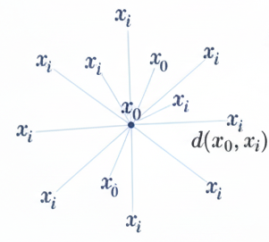
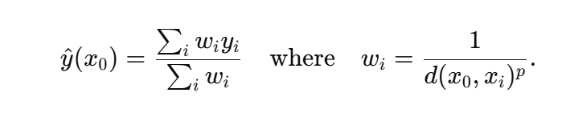
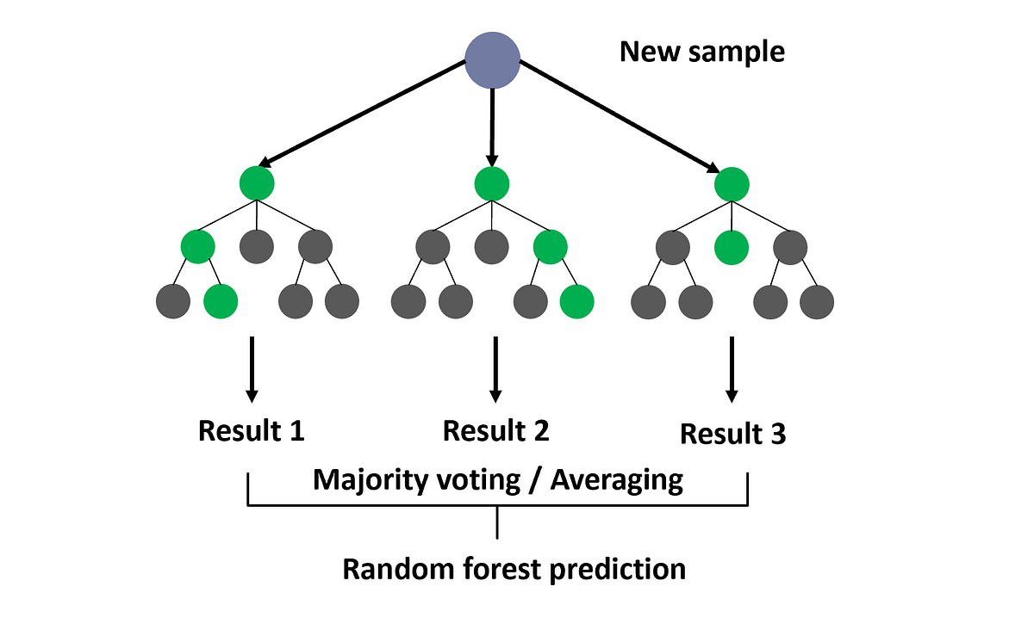
3. Model choice
3.1 Baseline Models: IDW & Random Forest
Model 1: Inverse Distance Weighting (IDW)
Model 2: Random forest model
Ensemble of many decision trees (bagging)
Captures nonlinear relationships effectively
Treats (row,col,time) as regular features
Robust to noise and requires little tuning
No uncertainty quantification
Not a spatiotemporal model → may produce non-smooth spatial patterns
Deterministic spatial interpolation
Local weighted averaging of nearby observations
Weights decay with distance
Applied independently for each day → no temporal modeling
No uncertainty quantification
Simple, fast, and widely used as a baseline method
3/18

Slide 5
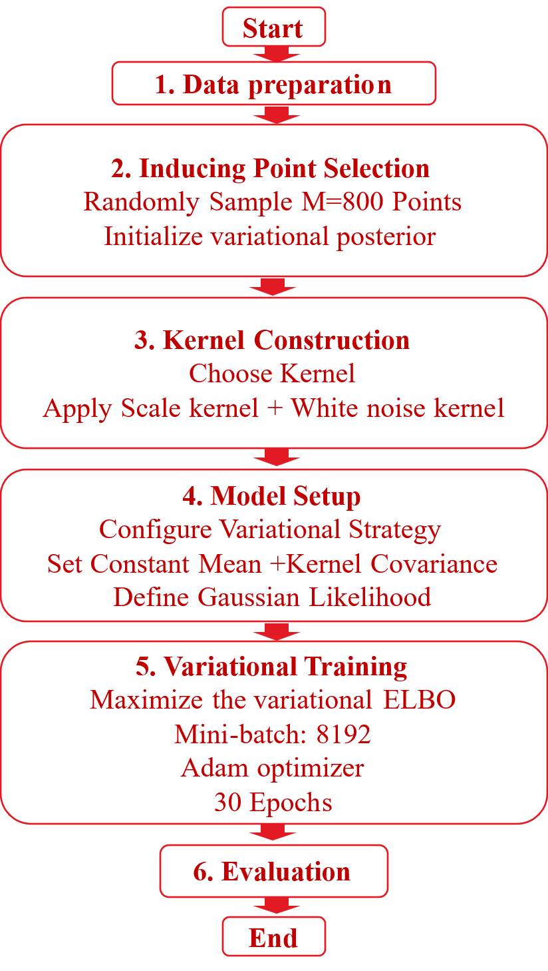
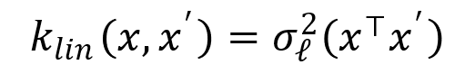
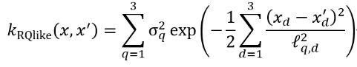
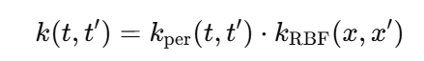
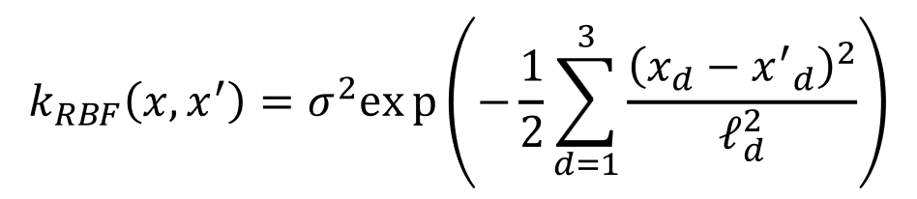
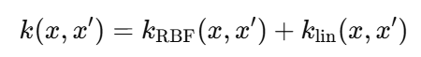
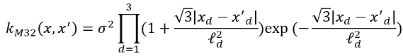
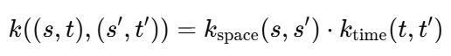
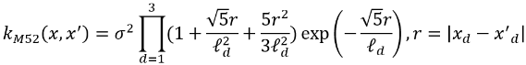
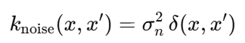
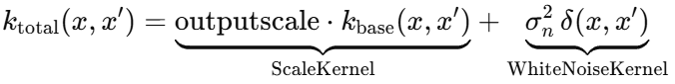
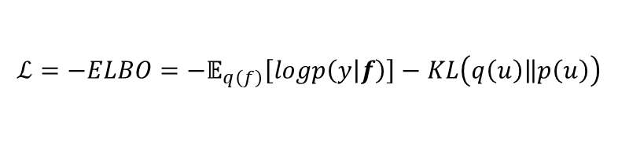
4/18
3.2 Sparse Variational Gaussian Process (SVGP)
SVGP Kernel Designs and Structures
Base Kernels
Additive Kernels
Separable Kernels
K1: Linear
K5: RQ-Like
K7: Periodic ×RBF
Periodic kernel × RBF
K2: RBF
K6: RBF + Linear
K8: Space ×Time
Matern-3/2 over space× RBF over time
K3: Matern-3/2
K3: Matern-5/2
$$ℒ={−ELBO=−𝔼}_{q\left(f\right)}\left[logp\left(y | f\right)\right]−KL\left(\left.q\left(u\right)\right\|p\left(u\right)\right)$$
Plus
White Noise Kernel
Minimize the negative ELBO

Slide 6
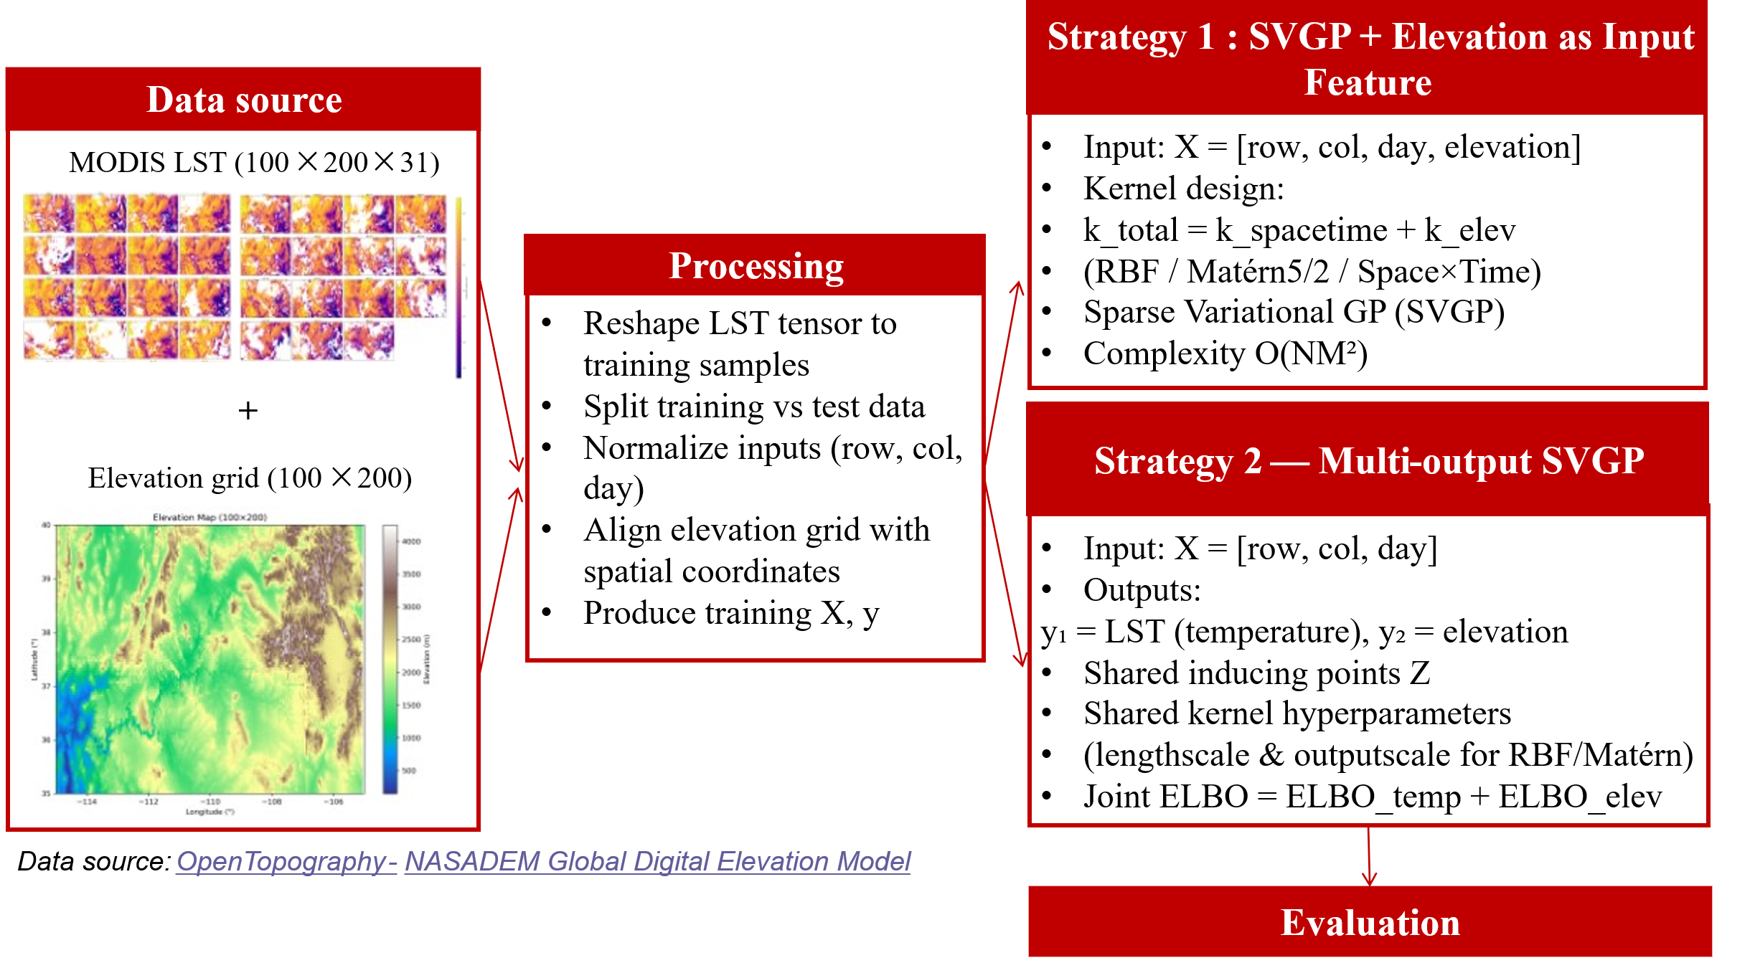
3.3 SVGP with elevation
5/18

Slide 7

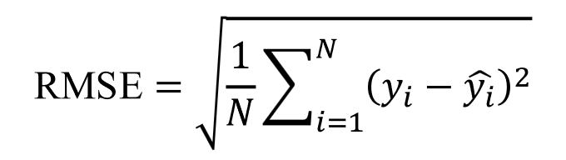
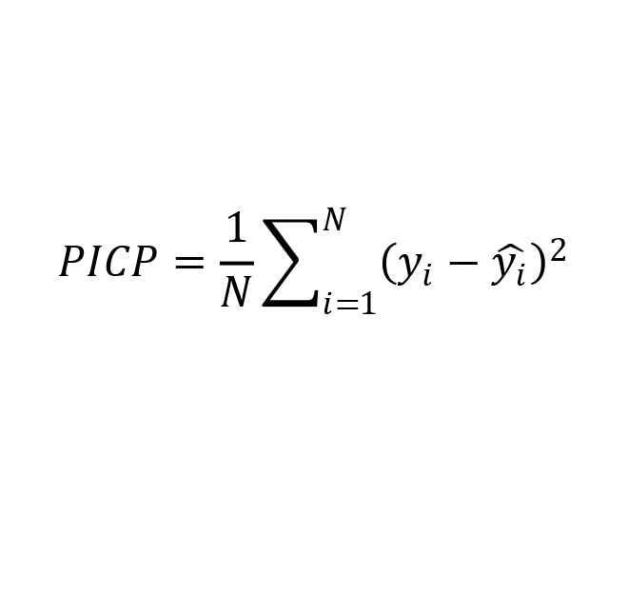
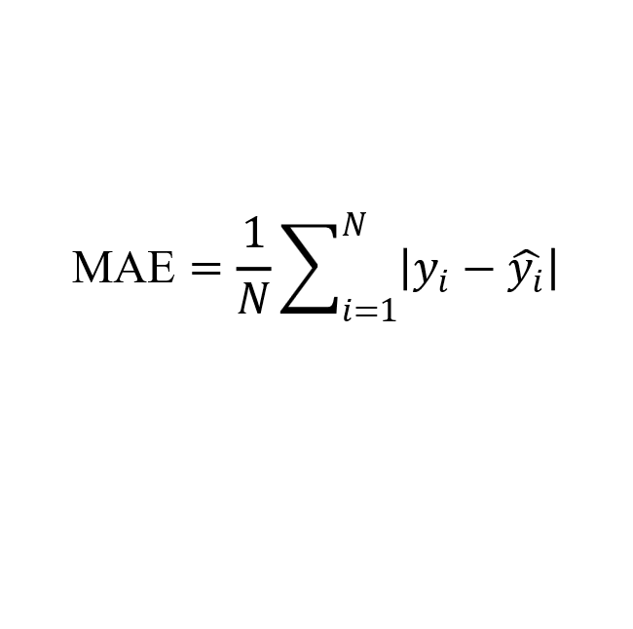
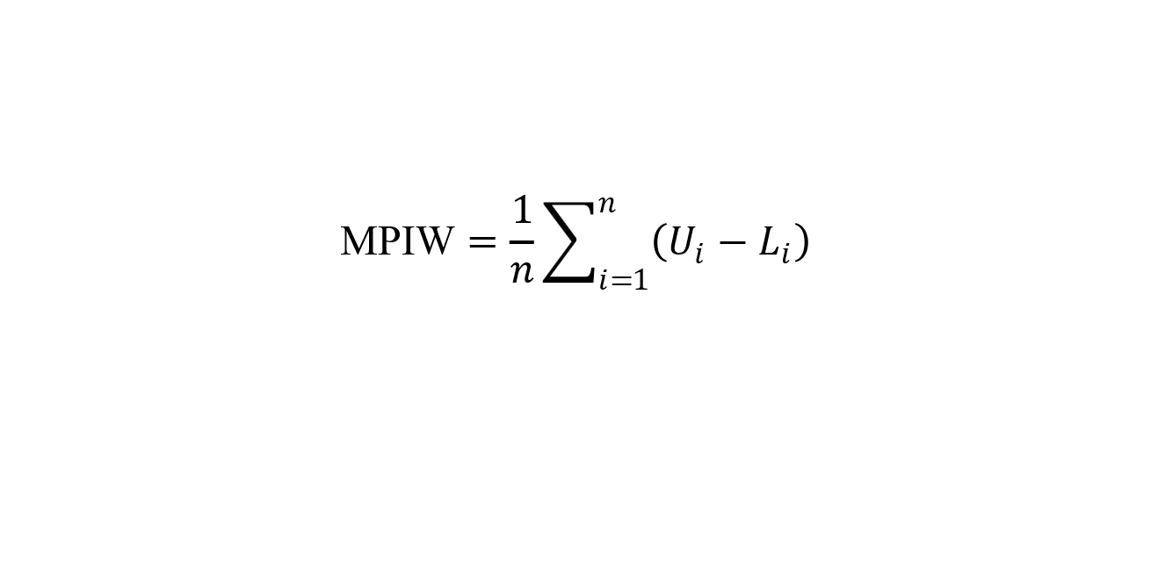
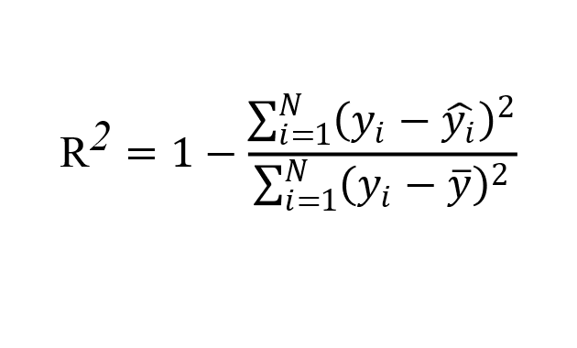
4. Metrics Design and computation cost
Probabilistic Metrics
[4] Continuous Ranked Probability Score (CRPS)
Error-based Metrics
[1] Root Mean Squared Error (RMSE)
Interval Metrics
Model Evaluation Metrics
[5] Prediction Interval Coverage Probability (PICP)
[2] Mean Absolute Error
(MAE)
[6] Mean Prediction Interval Width (MPIW)
[3] Coefficient of Determination
Efficiency
[7]Training Time
6/18

Slide 8
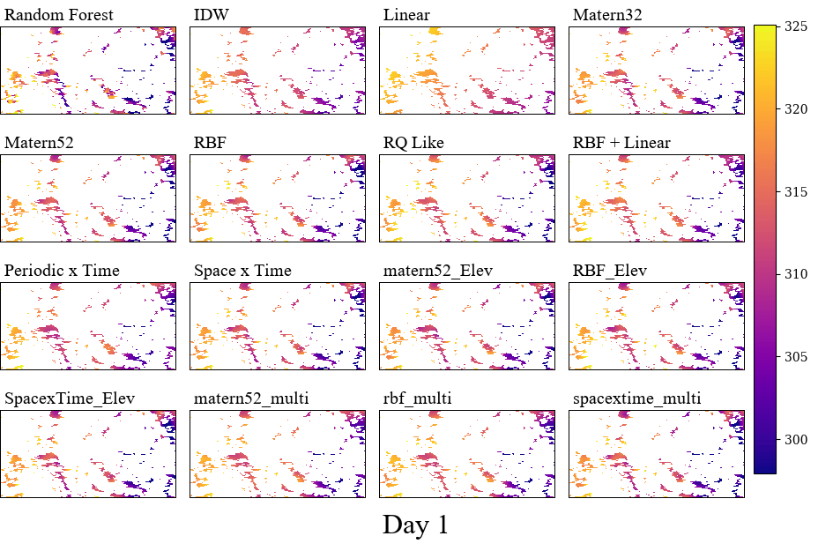
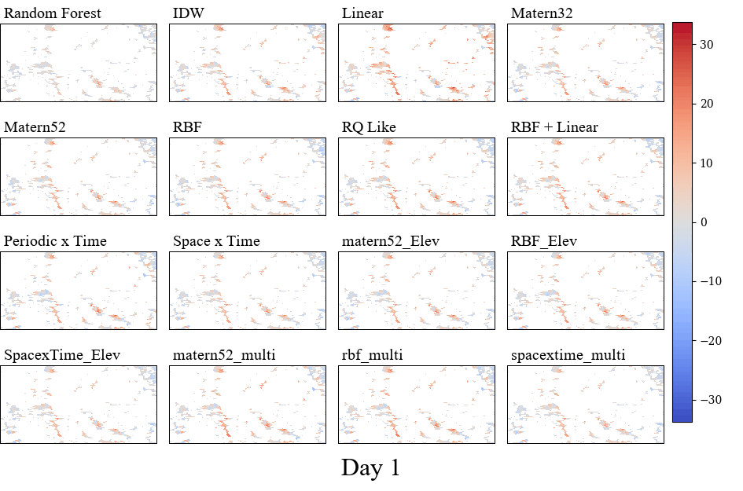
5. Results
5.1 Results Overview
Prediction maps
Error maps
7/18

Slide 9
5.2 Metrics Results
Model | Kernel | RMSE (K) | MAE | R2 | CRPS | PICP | MPIW | Time(s)
IDW | / | 6.20 | 4.73 | 0.47 | / | / | / | 47.09
Random Forest | / | 3.56 | 2.53 | 0.83 | / | / | / | 4.90
SVGP | Linear | 7.39 | 5.96 | 0.25 | 4.17 | 0.95 | 28.02 | 263.32
 | RBF | 4.73 | 3.72 | 0.69 | 2.65 | 0.96 | 19.23 | 282.76
 | Matern3/2 | 4.60 | 3.59 | 0.71 | 2.58 | 0.96 | 19.41 | 311.14
 | Matern5/2 | 4.59 | 3.58 | 0.71 | 2.56 | 0.95 | 18.79 | 303.28
 | rq_like(Mixture of RBFs) | 4.99 | 3.91 | 0.66 | 2.79 | 0.95 | 20.13 | 329.13
 | RBF + Linear | 5.03 | 3.91 | 0.65 | 2.80 | 0.95 | 20.26 | 300.58
 | Periodic× time | 5.47 | 4.24 | 0.59 | 3.04 | 0.94 | 20.39 | 324.39
 | Space×time Matern3/2(x, y)×RBF(t) | 4.40 | 3.43 | 0.73 | 2.46 | 0.96 | 18.27 | 314.06
SVGP+ Elevation (input feature) | RBF_Elev | 4.76 | 3.73 | 0.69 | 2.67 | 0.96 | 19.52 | 398.81
 | Matern5/2_Elev | 4.62 | 3.62 | 0.71 | 2.59 | 0.96 | 19.13 | 381.83
 | Space×time_Elev | 4.44 | 3.46 | 0.73 | 2.48 | 0.96 | 18.45 | 347.45
Multi-output SVGP | RBF_multi | 5.34 | 4.18 | 0.61 | 2.98 | 0.94 | 20.64 | 690.73
 | Matern5/2_multi | 5.26 | 4.12 | 0.62 | 2.94 | 0.94 | 20.36 | 592.98
 | Space×time_multi | 4.44 | 3.47 | 0.73 | 2.48 | 0.95 | 18.23 | 630.96
8/18

Slide 10
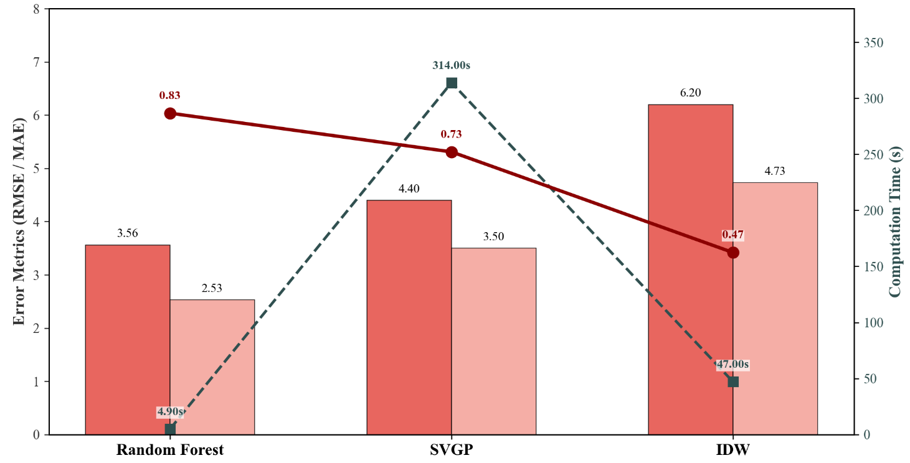
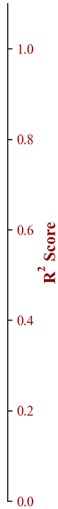
5.3 Comparaison of different models
Model | Kernel | RMSE | MAE | R2 | CRPS | PICP | MPIW | Time(s)
IDW | / | 6.20 | 4.73 | 0.47 | / | / | / | 47.09
Random Forest | / | 3.56 | 2.53 | 0.83 | / | / | / | 4.90
SVGP | Space×time | 4.40 | 3.43 | 0.73 | 2.46 | 0.96 | 18.27 | 314.06
Random Forest (Best Accuracy)
Lowest RMSE, Highest R², Fastest model
Limitation: No uncertainty estimates
2. SVGP (Best Probabilistic Performance)
Good accuracy
Provides well-calibrated uncertainty
Trade-off: Highest computational cost (314 s)
3. IDW (Weakest Performance)
Highest error, Lowest R², No uncertainty estimation
Moderate runtime (47 s)
9/18

Slide 11
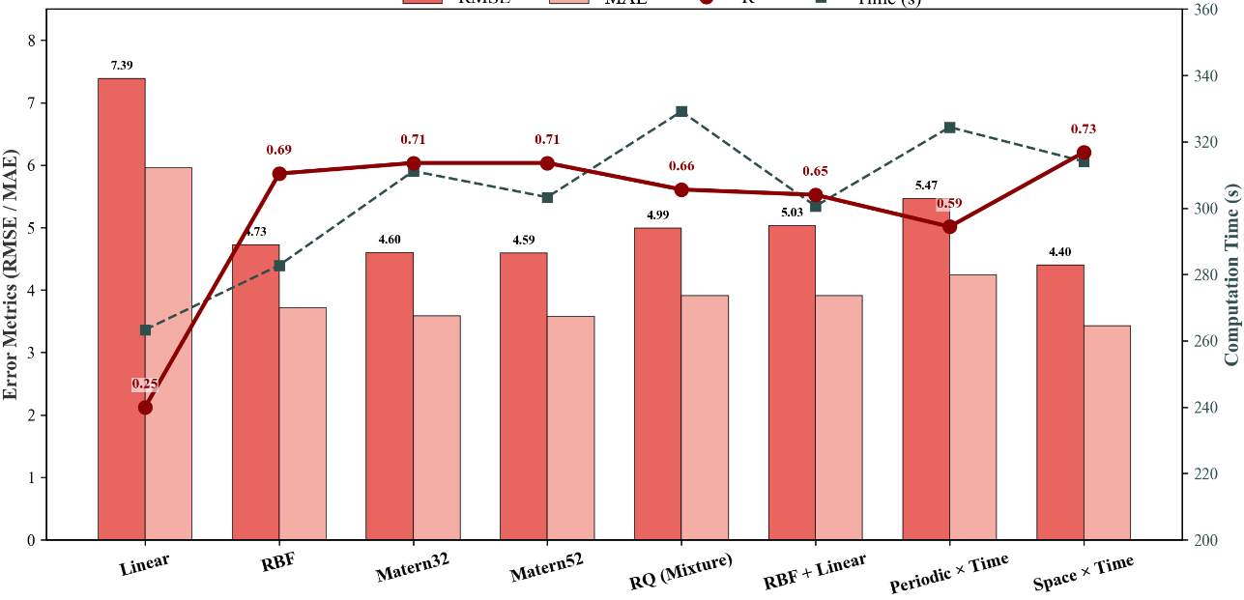
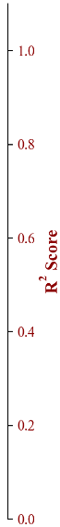
5.4.1 Comparaison of different kernels
Model | Kernel | RMSE | MAE | R2 | CRPS | PICP | MPIW | Time(s)
SVGP | Linear | 7.39 | 5.96 | 0.25 | 4.17 | 0.95 | 28.02 | 263.32
 | RBF | 4.73 | 3.72 | 0.69 | 2.65 | 0.96 | 19.23 | 282.76
 | Matern3/2 | 4.60 | 3.59 | 0.71 | 2.58 | 0.96 | 19.41 | 311.14
 | Matern5/2 | 4.59 | 3.58 | 0.71 | 2.56 | 0.95 | 18.79 | 303.28
 | rq_like(Mixture of RBFs) | 4.99 | 3.91 | 0.66 | 2.79 | 0.95 | 20.13 | 329.13
 | RBF + Linear | 5.03 | 3.91 | 0.65 | 2.80 | 0.95 | 20.26 | 300.58
 | Periodic× time | 5.47 | 4.24 | 0.59 | 3.04 | 0.94 | 20.39 | 324.39
 | Space×time | 4.40 | 3.43 | 0.73 | 2.46 | 0.96 | 18.27 | 314.06
Space–Time kernel
→ most effective and best calibrated
2. Matern kernels
→ reliable, strong alternatives
3. RBF
→ moderate models
4. Composite and Linear kernels
→ significantly less effective
10/18

Slide 12
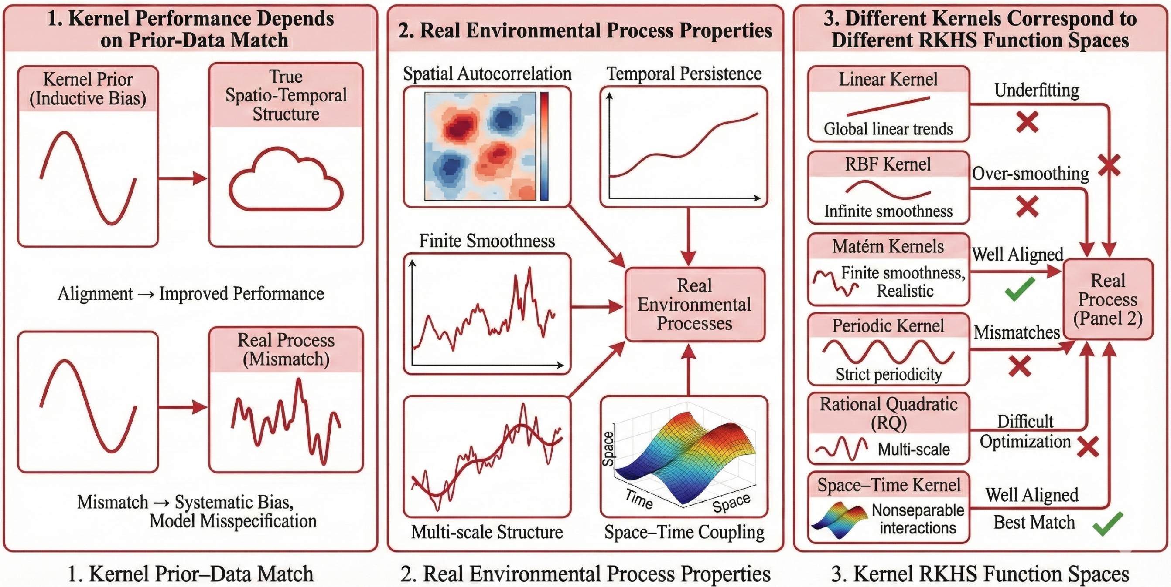
5.4.2 Why Different Kernels Perform Differently
11/18

Slide 13
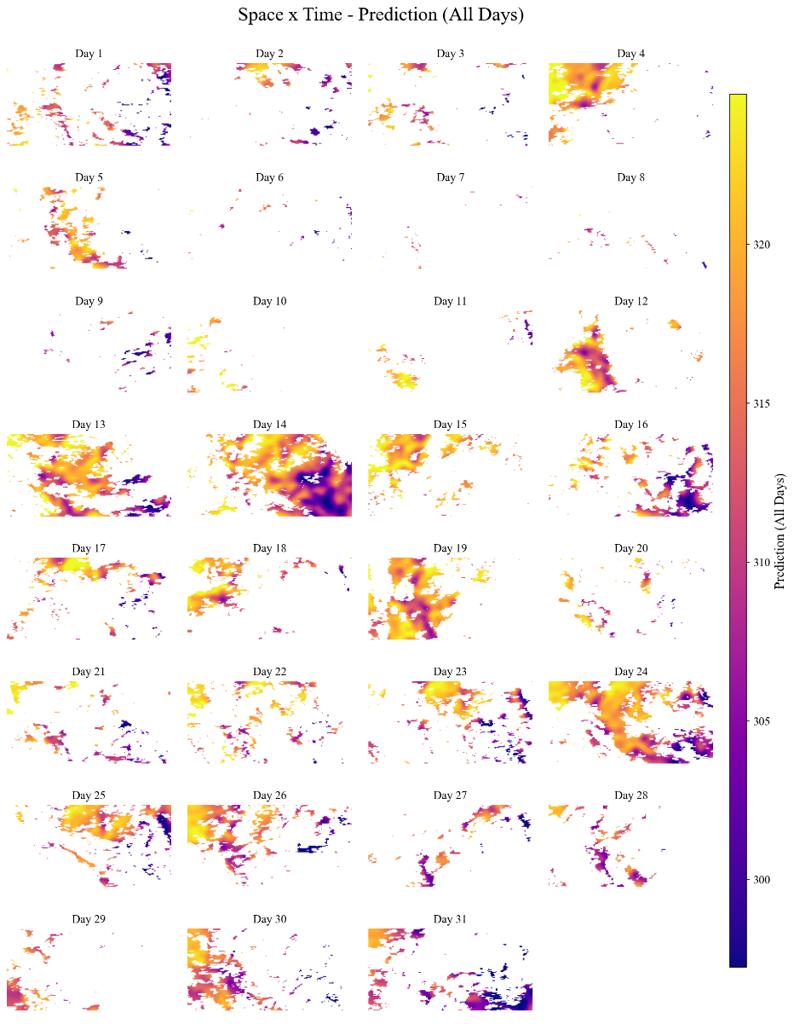
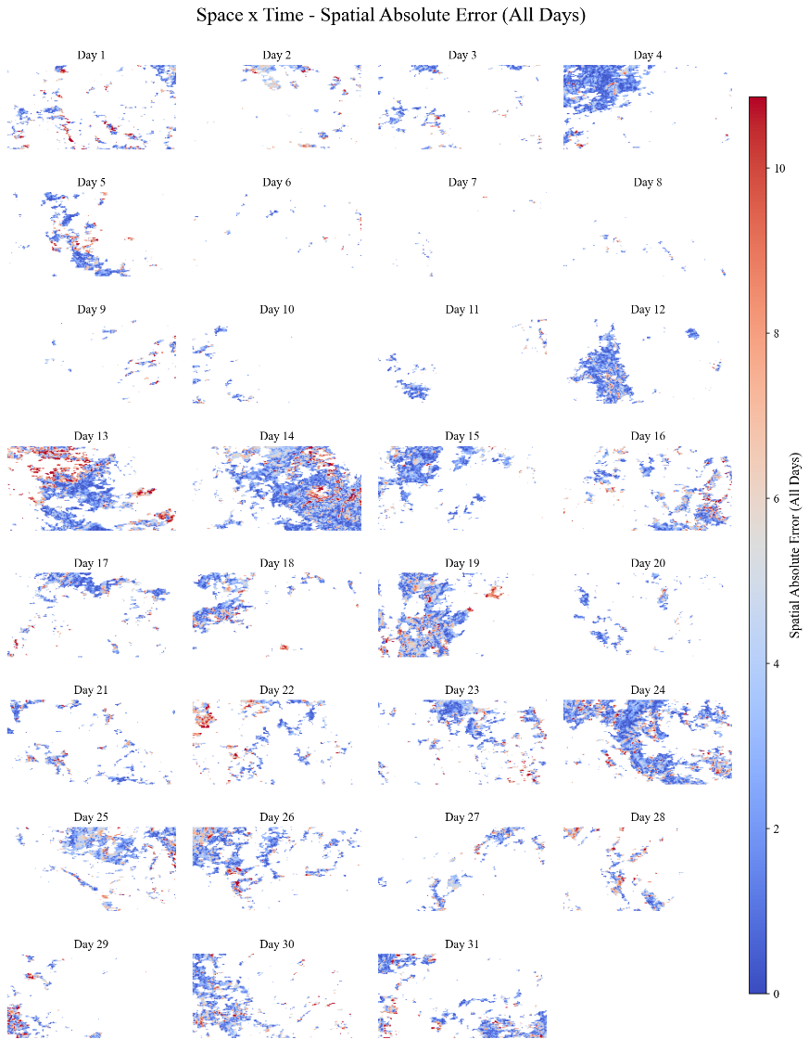
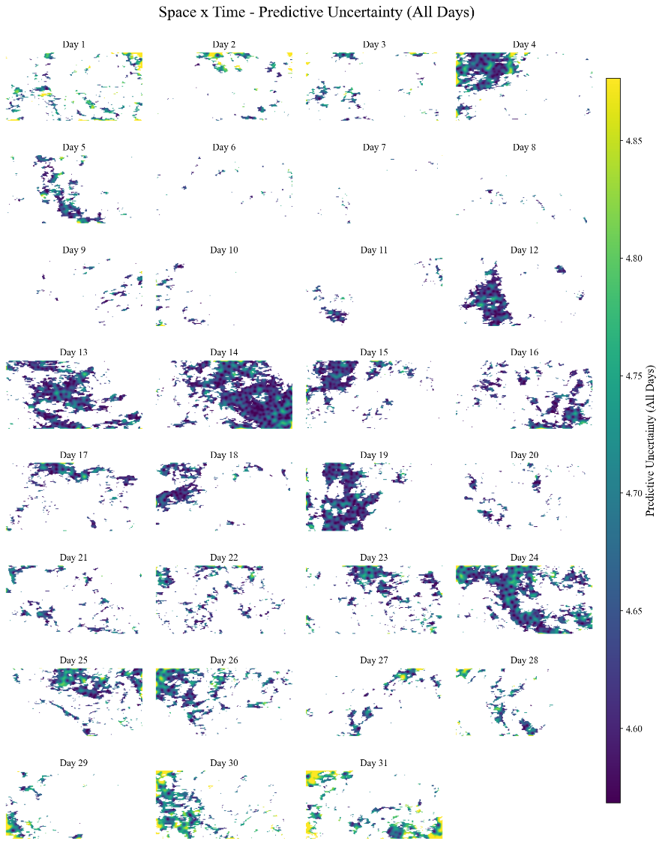
5.4.3 Spatio-Temporal Results of the Space × Time Kernel
Space × Time Kernel: Spatial Absolute Error
Space × Time Kernel: Predictive Uncertainty
Space × Time Kernel: Prediction
12/18

Slide 14
5.4.4 Interpreting the Space × Time Kernel Performance
1. Prediction Maps: Strong Spatio-Temporal Coherence
2. Spatial Error: Concentrates in High-Variability Regions
3. Predictive Uncertainty: Well-Calibrated & Interpretable Patterns
Smooth spatial gradients and temporally consistent evolution patterns across all 31 days.
Capture nonseparable spatio-temporal dependencies (broad patterns & localized transitions)
Errors remain mostly low, consistent with strong RMSE/R² performance.
Discrepancies localize in areas with:
-Rapid temporal changes
-Strong spatial gradients
-Dynamic boundaries
Spatially structured (Not noise)
Forms coherent patterns representing systematic epistemic uncertainty
Physically Meaningful:
Uncertainty increases in:
-Data-sparse regions
-Complex dynamics or rapid changes
Excellent Calibration
High sharpness (narrow intervals) + correct coverage (PICP=0.96) indicates an exceptionally well-calibrated GP.
4. Integrated Interpretation: Model Validation
Accurate mean predictions, spatially coherent and interpretable residual patterns, well-structured, meaningful uncertainty estimates aligned with both data density and physical complexity.
13/18
6/11

Slide 15
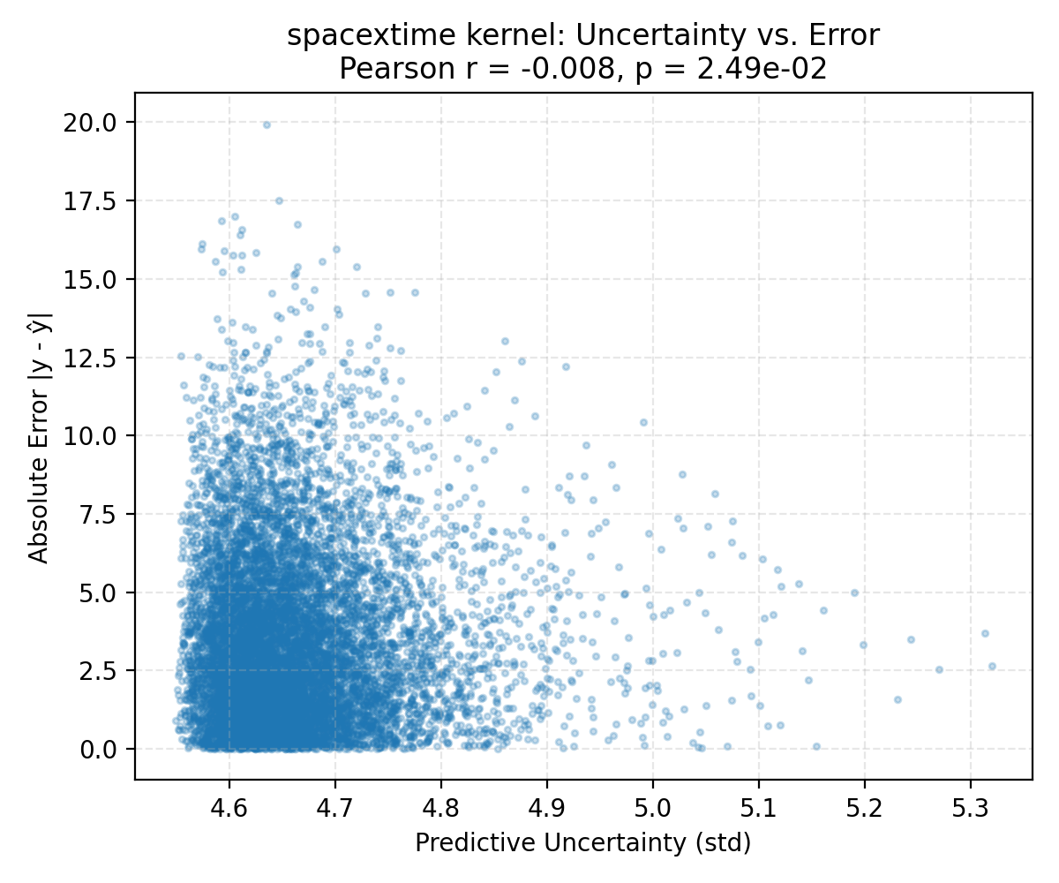
5.4.5 Relationship Between Predictive Uncertainty and Error
Why This Happens:
Variational Posterior Variance Collapse
→ predictive std falls within a very narrow range
Homoscedastic Gaussian Likelihood
→ predictive uncertainty is largely dominated by data geometry (distance to training samples) rather than the intrinsic difficulty of the prediction task.
Strong Smoothness Imposed by the Space–Time Kernel
Environmental Data Are Highly Smooth
Implications:
Uncertainty Does Not Track Error
Globally Calibrated but Not Locally Calibrated
Uncertainty Reflects Data Density, Not Epistemic Risk
Key Finding: Predictive uncertainty (std) from the Space–Time SVGP is almost uncorrelated with actual prediction error.
14/18

Slide 16
5.5.1 Effect of Incorporating Elevation into the SVGP Model
Model | Kernel | RMSE | MAE | R2 | CRPS | PICP | MPIW | Time(s)
SVGP | RBF | 4.73 | 3.72 | 0.69 | 2.65 | 0.96 | 19.23 | 282.76
 | Matern5/2 | 4.59 | 3.58 | 0.71 | 2.56 | 0.95 | 18.79 | 303.28
 | Space×time | 4.40 | 3.43 | 0.73 | 2.46 | 0.96 | 18.27 | 314.06
SVGP+ Elevation (input feature) | RBF_Elev | 4.76 | 3.73 | 0.69 | 2.67 | 0.96 | 19.52 | 398.81
 | Matern5/2_Elev | 4.62 | 3.62 | 0.71 | 2.59 | 0.96 | 19.13 | 381.83
 | Space×time_Elev | 4.44 | 3.46 | 0.73 | 2.48 | 0.96 | 18.45 | 347.45
Multi-output SVGP | RBF_multi | 5.34 | 4.18 | 0.61 | 2.98 | 0.94 | 20.64 | 690.73
 | Matern5/2_multi | 5.26 | 4.12 | 0.62 | 2.94 | 0.94 | 20.36 | 592.98
 | Space×time_multi | 4.44 | 3.47 | 0.73 | 2.48 | 0.95 | 18.23 | 630.96
Adding Elevation as an input yields only marginal gains
Minimal improvement (e.g., 4.40 → 4.44)
20–30% higher computation
Indicates elevation effect is mostly absorbed by spatial coordinates
Multi-output SVGP increases cost but not accuracy
Training time nearly doubles
Very similar RMSE and R²
Cross-output correlation too weak to offer benefit
15/18

Slide 17
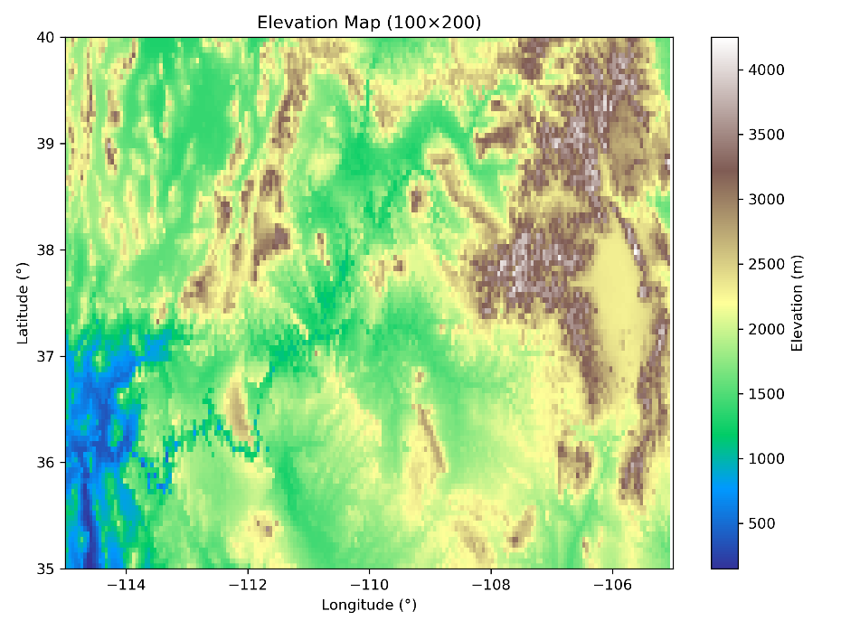
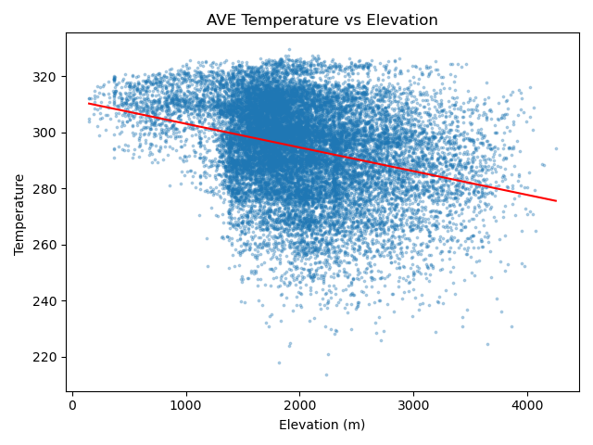
5.5.2 Why Elevation Fails to Improve Prediction Accuracy
Insights from Temperature–Elevation Scatter Plot
Clear global negative trend → elevation matters
But large vertical spread → strongly nonstationary & heteroscedastic effect
Elevation strongly collinear with spatial coordinates
Sparse high-elevation samples
Why Elevation Adds Little Benefit?
Elevation–temperature relationship is nonstationary
Spatial coordinates already encode major elevation trends
Uneven elevation distribution impairs uncertainty learning
Model ends up capturing only a weak global trend
Why Multi-output SVGP Fails to Improve Performance?
Cross-output correlation is weak → limited information sharing
Shared inducing points lead to underfitting each output
Increased complexity does not increase representation power
High computational cost with minimal benefit
16/18

Slide 18
6. Conclusion
1. SVGP provides a principled probabilistic framework
Balances predictive accuracy and uncertainty quantification.
More suitable for environmental modeling than deterministic methods (RF/IDW).
2. Space × Time kernel achieves the best performance
Captures spatial autocorrelation and temporal continuity.
Best results in RMSE, spatial coherence, and probabilistic metrics (CRPS/PICP).
3. Elevation contributes limited improvement
Temperature–elevation relationship is highly non-stationary.
Latitude/longitude already encode most terrain structure → marginal gain.
Multi-output GP increases computational cost with little benefit.
4. Key limitation: local uncertainty does not track error
Variational inference leads to variance collapse and narrow predictive std.
Global calibration is good, but uncertainty ≠ local error.
17/18

Slide 19
7. Future work
1. Improved uncertainty modeling
Heteroscedastic or non-Gaussian likelihoods for adaptive local uncertainty.
2. More expressive kernels
Deep Kernel Learning (DKL), non-stationary kernels, spatially varying length-scales.
3. Enhanced calibration
Conformal Prediction for locally reliable prediction intervals.
18/18

Slide 20
CIVE 650 – Spatiotemporal Data Mining
Course project presentation
Thanks for your listening!
Presenter: Xiaoning Sun
Student number: 261162300

